Slide 1
Organic Products and its Consumers
Nik Baldis
Notes:
Hello, my name is Nik Baldis, and I am presenting a few models that will help connect organic products with the correct customers.

Slide 2
business problem
Identify organic product consumers
Investigate factors that increase the likelihood of purchasing organic products
Create a target consumer to market to
Notes:
I have created four models that will help to identify customers who are most likely to purchase organic products, identify the key factors that increase the likelihood of buying organic products, and help to create an image of the typical organic product purchaser.

Slide 3
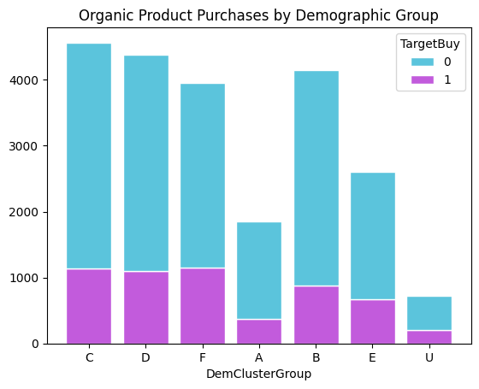
Exploratory Analysis: Organic Products Purchased by Demographic Group
Cluster F slightly edges out Cluster C and D for Organic Product Purchases
Clusters A and U do not purchase a lot of products in general
Organic Marketing efforts should go to Clusters B, C, D, and F
Notes:
The first aspect to explore through the data was the amount of organic products purchased by the different neighborhood groups the customers belong to. Through this analysis, I found that Cluster C is leading in total sales, but Cluster F is slightly edging out Group C and D for the top demographic of organic product purchases. Cluster A and U are rare purchasers of any product, so it may be best to leave them out of marketing efforts in general. Clusters, B, C, D, and F are likely the best groups to market any product to, especially organic products.

Slide 4
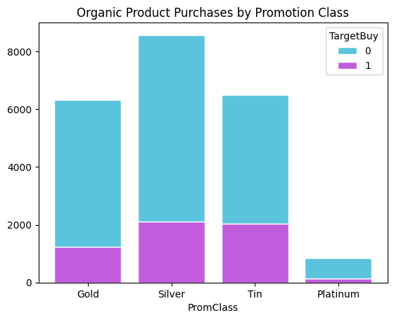
Exploratory Analysis: Organic Products by Promotion Class
Silver and tin class customers are nearly identical in organic product purchases
Platinum class customers do not make up a lot of supermarket sales
May be best to market toward silver and tin class customers
Notes:
The second aspect to investigate was the amount of organic product purchases among loyalty program classes. The Tin and Silver classes are nearly identical in organic purchases, so it would be wise to lean into those loyalty classes for organic purchases. The platinum class is drastically behind the three other classes in terms of both organic sales and total sales. However, this may be an issue with the number of consumers in that loyalty class rather than an issue of consumers not buying products. It is best to market toward the Silver and Tin classes, as they are the most likely to buy organic products.

Slide 5
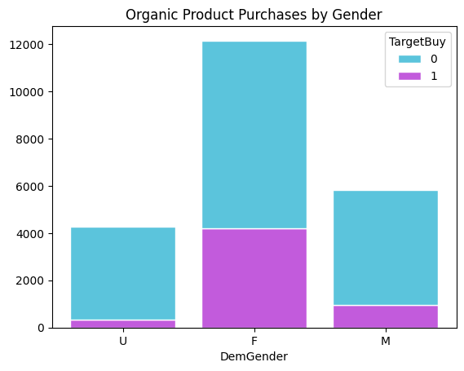
Exploratory Analysis: Organic Products by Demographic Group
Female Gender is far and away the biggest purchaser of supermarket products
Males are the second highest purchasers of product
Notes:
The third exploratory analysis examined the relationship between organic product purchases and gender. Females are by far the largest purchaser of products in general, with about double the number of purchases as males. They are also much more likely to purchase organic products, as organic purchases make up about a third of their total product purchases. The supermarket should focus on marketing toward the female demographic, as they are more likely to purchase organic products.

Slide 6
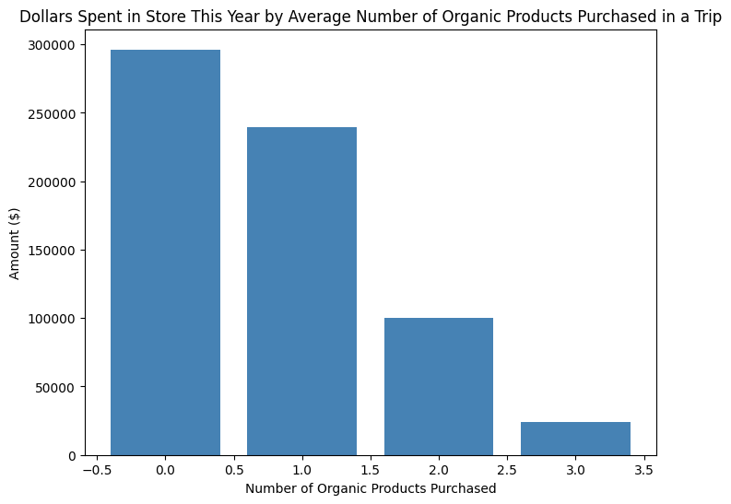
Exploratory Analysis: Organic Products by Demographic Group
Very linear relationship
Also a steep drop from customers averaging one purchase to two and three purchases
Notes:
This exploratory analysis examined the relationship between dollars spent this year at the supermarket and the average number of organic products purchased. Interestingly, a linear relationship exists between the number of products purchased and the amount spent in-store. Customers who do not buy organic products have spent the most at the supermarket, and there is a steep drop in revenue from customers who average one purchase to customers who average two organic purchases. However, this information can be helpful for promotions to increase the money spent by consumers who purchase more than one organic product.

Slide 7
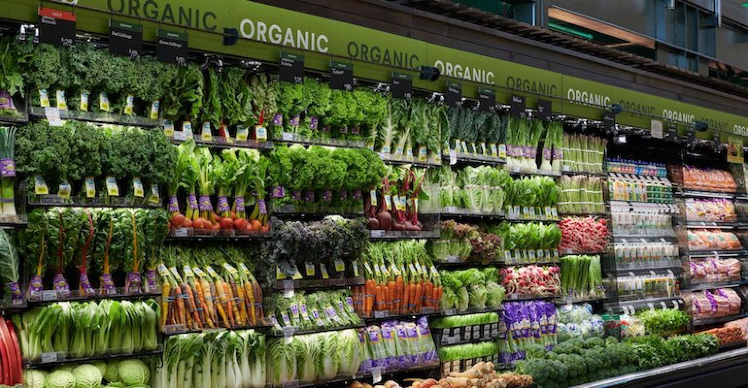
Exploratory Analysis: Do customers that Buy Organic Products Spend more on Average than Customers that Do not?
Customers that buy organic products surprisingly spend less money ($3,367.83) in the supermarket than those that do not buy organic products ($4,767.25)
Notes:
The last aspect of exploratory analysis for this data was whether organic product consumers spend more on average than customers who do not buy organic products. Surprisingly, organic product consumers spend over a thousand dollars less than those who do not buy organic products. The possibility of organic products saving people money could be a compelling selling point for future marketing efforts.

Slide 8
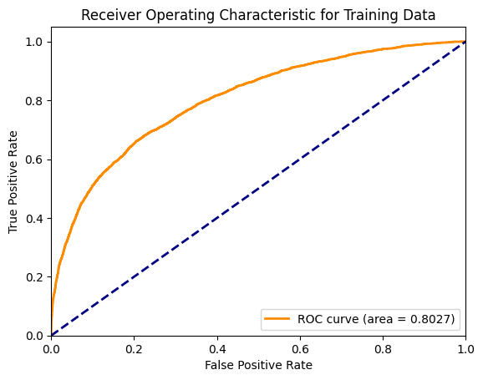
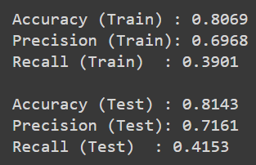

Predictive Analysis: Basic Logistic regression Model
Accuracy and Precision for both the training and test data sets are decent
Recall is very bad
Correctly predicting actual organic product purchasers at 41%
Notes:
A logistic regression model is used for predicting binary responses. In this case, whether or not a customer will buy an organic product. This full logistic regression model found that the customer’s affluence and age were significant factors in predicting that a customer would buy an organic product. The accuracy, precision, and recall are calculated to evaluate this model. The accuracy of the model is the percentage of correctly identified observations. The precision is the proportion of actual organic purchases divided by the model’s predicted organic purchases. The recall is the proportion of actual organic purchases identified correctly divided by the total actual organic purchases. The accuracy and precision of the model are decent. However, the recall is terrible, with a 41% chance of correctly predicting actual organic product consumers. The area under the curve is another way to evaluate a model. The closer the AUC value is to 1, the better the model is at classifying whether the consumer will purchase organic products. A value closer to the middle 0.5 line means that the model cannot distinguish between customers who will buy an organic product and those who will not. The area under the curve for the model’s training dataset was 0.8027, and the AUC for the model’s test dataset was 0.8103. The AUC for the full regression model is promising, but the recall is too low to give confident predictions.

Slide 9
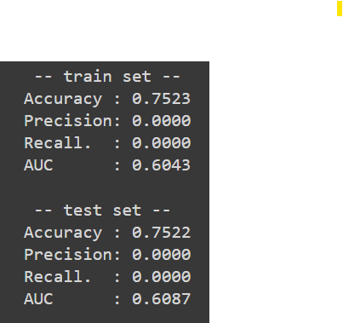
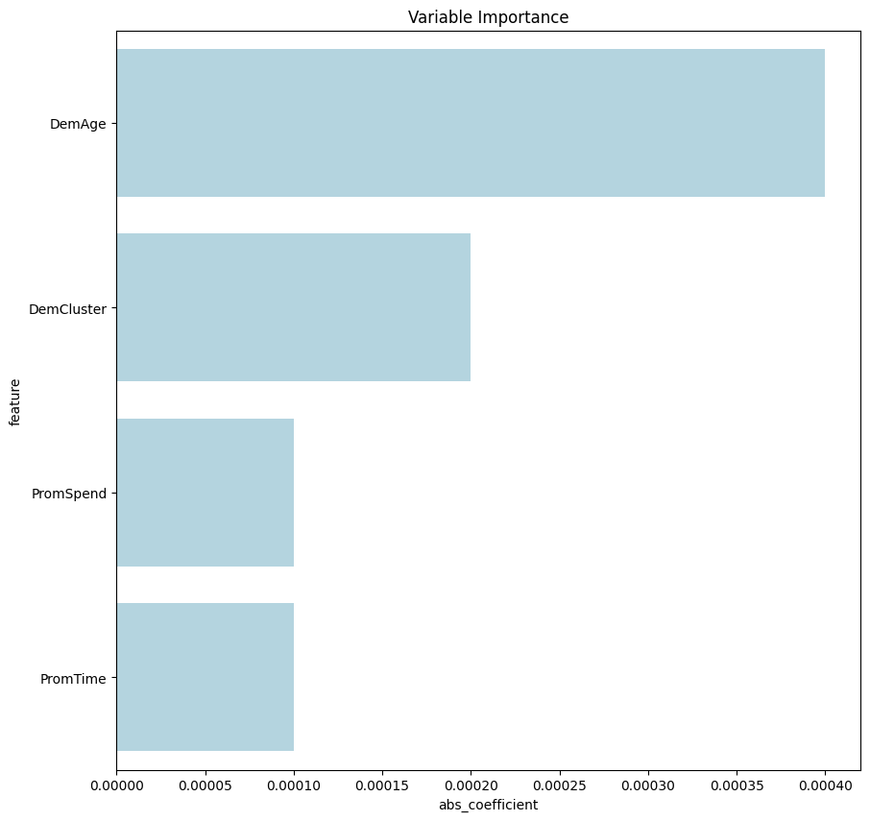
Predictive Analysis: Elastic Net Logistic regression Model
Surprisingly high accuracy and very similar between the training and testing set
Obviously terrible for predicting the target of organic product purchasers
Model could be used for other projects or different data sets
Notes:
An elastic net logistic regression is a method to improve a model’s predictions by eliminating and reducing the impact of features that the model deems insignificant. With this model, the customer’s age, the type of residential neighborhood they lived in, the amount they spent in the store this year, and their time as loyalty card members were significant factors in predicting organic purchases. The model’s accuracy is pretty good, nearly the same as the full logistic regression. However, the model did not predict a single organic customer correctly, which is an issue if the goal is to predict customers who would buy organic products. The AUC is also not very good, only about 10% better at classifying whether a customer will purchase an organic product as flipping a coin. This model is not a suitable classifier for organic product purchasers. Still, the relatively high accuracy means that the model classifies those who did not purchase organic products well. Therefore, this model may be helpful for another project.

Slide 10
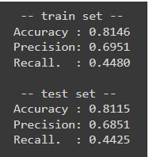
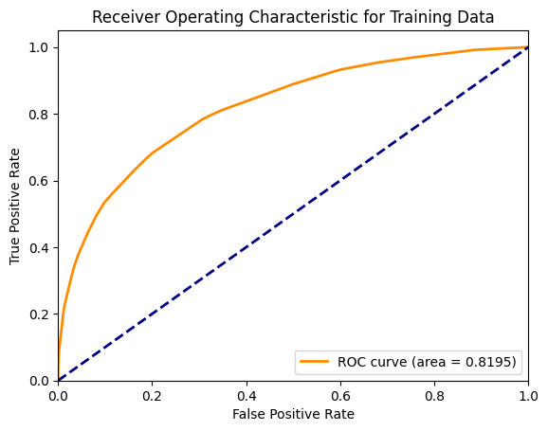

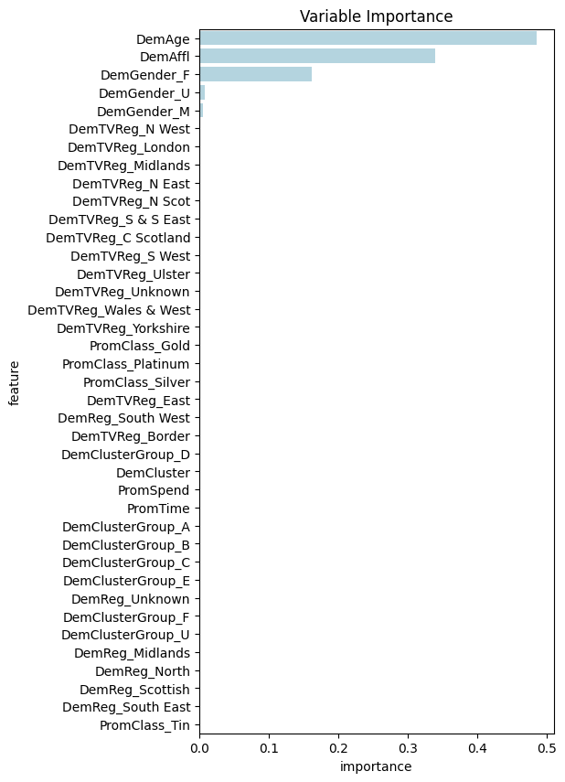
Predictive Analysis: Basic Decision Tree Model
Very similar metrics to the full logistic regression
Lower precision, overall slightly higher accuracy and recall
AUC is better across the board compared to the full logistic regression
Notes:
A decision tree is another method for selecting the most important variables corresponding to the target predicting organic product purchases. Visualized decision trees are also very good at telling stories about a customer by following the granular roads that the model creates to determine the probability of a specific response from the customer. For this basic decision tree model, the most important variables for predicting whether a customer will buy an organic product are age, affluence level, and gender. This model is similar to the full logistic regression model in that affluence and age were significant factors, and the evaluation metrics are very close. The accuracy for this model is consistent between the training and test set, which is promising, and the precision is decent. However, the recall is once again not very good overall, but slightly better than the full logistic regression and better than the elastic net logistic regression. The AUC is better for the training and testing datasets than the full logistic regression. This is the recommended model of the three so far.

Slide 11
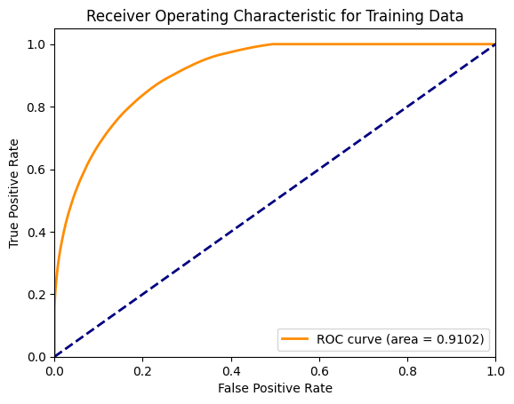
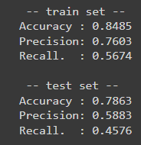
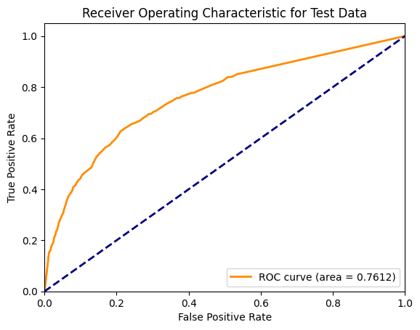
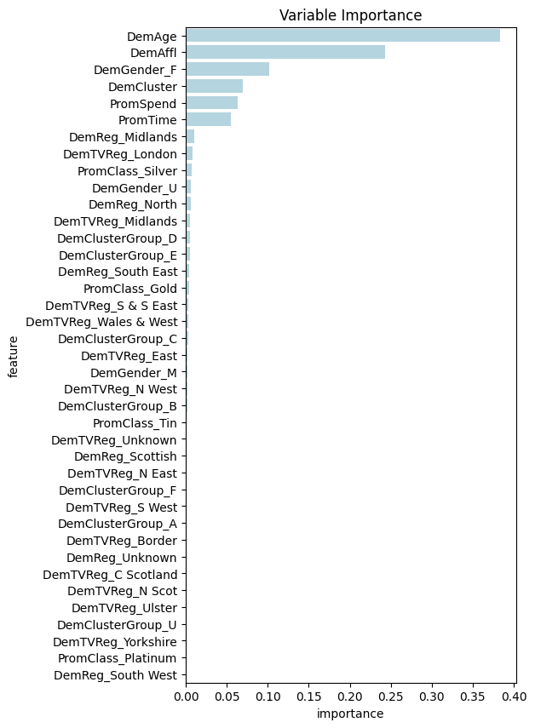
Predictive Analysis: Increased Depth Decision Tree Model
Type of neighborhood, total spent in the store this year, and time as a loyalty member added to important variables
Training metrics increased, but test metrics got worse
Notes:
The final potential model to use to predict customers buying organic products is another decision tree, but with an increased depth. The depth of the decision tree determines how far the model can dive into the data for the target variable. In this case, the depth was multiplied by 6 to allow the tree to stretch more to make more accurate predictions. The model determined some new important variables other than age, affluence level, and gender. The new important variables are the type of neighborhood the customer lives in, the total spent in the store this year, and the customer’s time as a loyalty member, among other less significant variables. Unfortunately, increasing the depth only seemed to positively affect the model’s metrics for the training data set. The accuracy, precision, and recall significantly increased from the training set in the basic decision tree to the increased depth tree. The AUC increased by nearly 0.1 from 0.8195 in the basic decision tree to 0.9102 in the increased depth tree. Unfortunately, the model became less effective for the test dataset. Accuracy, precision, and AUC all fell dramatically compared to the basic decision tree. The model’s recall slightly increased, but the decrease in all other metrics is concerning. The basic decision tree is the recommended model of the four to predict customers that will buy organic products.

Slide 12
Final Table of Models
 | Training |  |  |  | Test
 | Accuracy | Precision | Recall | Area Under Curve | Accuracy | Precision | Recall | Area Under Curve
Basic Logistic Regression | 0.8069 | 0.6968 | 0.3901 | 0.8027 | 0.8143 | 0.7161 | 0.4153 | 0.8103
Elastic Net Logistic Regression | 0.7523 | 0.0000 | 0.0000 | 0.6043 | 0.7522 | 0.0000 | 0.0000 | 0.6087
Basic Decision Tree | 0.8146 | 0.6951 | 0.4480 | 0.8195 | 0.8115 | 0.6851 | 0.4425 | 0.8239
Increased Depth Decision Tree | 0.8485 | 0.7603 | 0.5674 | 0.9102 | 0.7863 | 0.5883 | 0.4576 | 0.7612
Notes:
This final table gives a quick glimpse of the different models and their metrics. I’ve highlighted the basic decision tree model, as that is the one that I would recommend using to predict future customers. Still, the basic logistic regression model is nearly as effective.

Slide 13

Description of the Typical Organic Customer
Female
Under 40
Between 10 and 15 Affluence level
Notes:
Following the decision tree, the typical organic product customer is a female under forty years of age, and her affluence level is between 10 and 15.

Slide 14

Exploratory Analysis: Organic Products by Demographic Group
Focus on a young adult female demographic with a relatively average affluence level
Could also push more toward the male demographic to bolster those low sales
Advertisements in neighborhood clusters B, C, D, and F could also boost sales
Notes:
To increase the sales of organic products, the easiest demographic to target is young adult females with an average affluence level, as they are the “typical” organic product customers. However, bolstering the lower-performing demographics, such as male customers, may be advantageous. The supermarket could also advertise in the lower-performing neighborhoods like A, E, and U to boost sales.

Slide 15
Thank You!
Any Questions?
Notes:
Thank you for your time, are there any questions?

